Slide 1
Integration/Execution Timeline

Slide 2
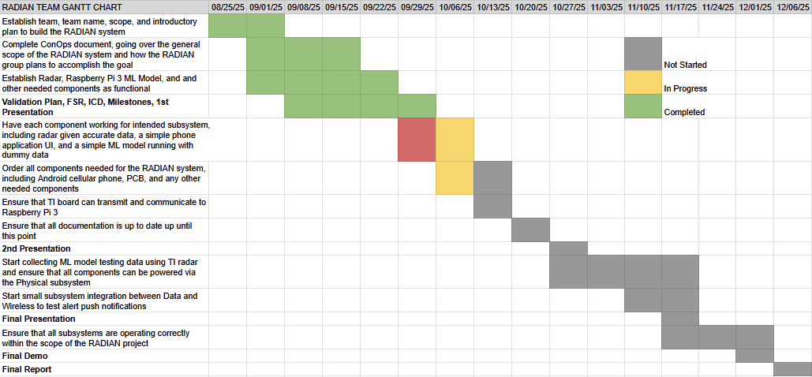
RADIAN Gantt Chart

Slide 3
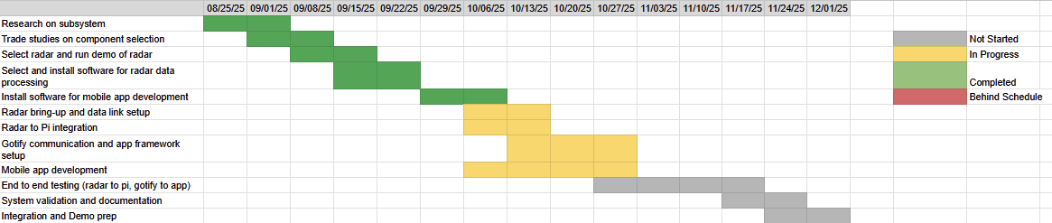
Wireless Gantt Chart
Mitchell Hoffman

Slide 4
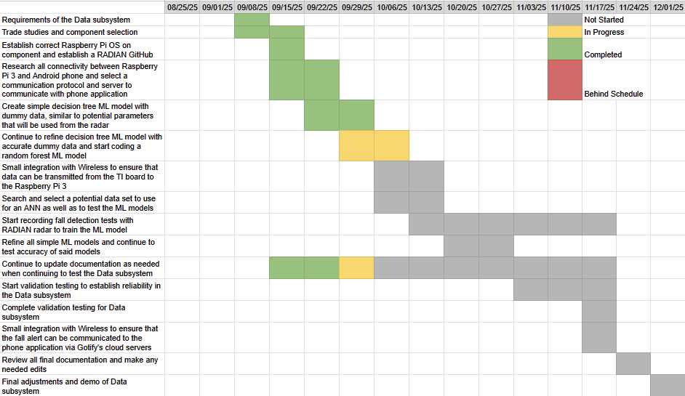
Data Gantt Chart
Matthew Blackwell

Slide 5
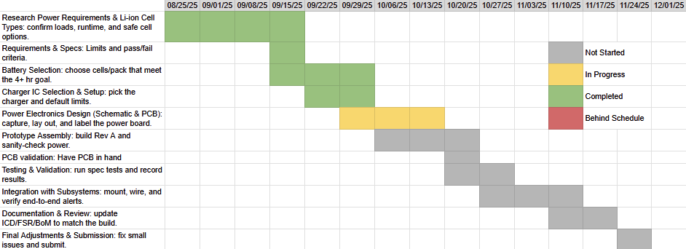
Physical Gantt Chart
Wyatt Johnson

Slide 6
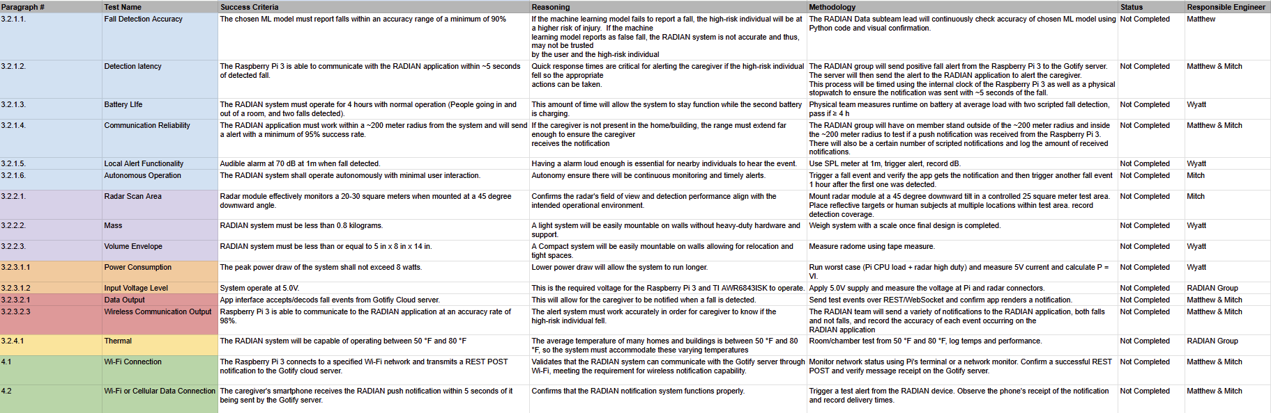
Validation Plan

